Slide 1
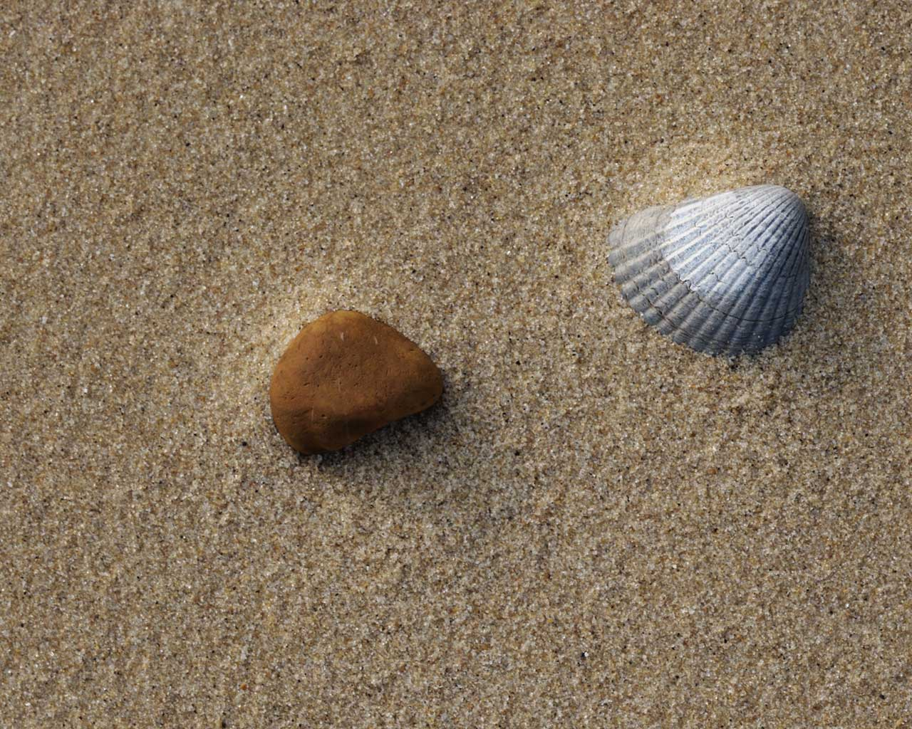

Slide 2
GOD’S SO BIG
God’s so big [God’s so big]
I’m so small [ I’m so small]
Why does he love me, love me at all?
Why does he love me, love me at all?

Slide 3
I’m so bad [I’m so bad]
God’s so good [God’s so good]
Why can’t I love Him
like I know that I should?
Why can’t I love Him
like I know that I should?

Slide 4
So often I’m selfish and mean,
So often I go my own way:
Loving myself instead of another,
Hurting my sister,
forgetting my brother,
Being a hater instead of a lover.
So often I go my own way.

Slide 5
I’m so weak [I’m so weak]
He’s so strong [He’s so strong]
Why does He want me
to Him to belong?
Why does He want me
to Him to belong?

Slide 6
His love is as high as the mountains,
His love is as deep as the sea,
His love is wider than the heavens above,
And His love is for you and for me.
His love is as strong as an earthquake,
His love is as bright as the sun,
His love will last forever and ever
And His love is for everyone.

Slide 7
I’m so weak [I’m so weak]
He’s so strong [He’s so strong]
Why does He want me
to Him to belong?
Why does He want me
to Him to belong?

Slide 8
His love is as high as the mountains,
His love is as deep as the sea,
His love is wider than the heavens above,
And His love is for you and for me.
His love is as strong as an earthquake,
His love is as bright as the sun,
His love will last forever and ever
And His love is for everyone.

Slide 9
God’s so big [God’s so big]
I’m so small [ I’m so small]
I’m so bad [I’m so bad]
God’s so good [God’s so good]
I’m so weak [I’m so weak]
He’s so strong [He’s so strong]

